Slide 1

Welcome!
To Our Presentation

Slide 2
Table of Contents
Team Members
Introduction
Problem Statement
Solution Overview
Database Design
Key Features
Patient Module
Doctor Module
Admin Module
System Architecture / Workflow
Technology Used
Conclusion
Q&A

Slide 3
Team Members
01
Abir Hasan
02
Sadia Yasmin
03
Md Shamiul Kabir Alvi
04
Umana Tahrim
Id: 22303364
Id: 22303235
Id: 22303297
Id: 22303258
05
Samiul Basher Shaan
Id: 22303195

Slide 4

Introduction!
TeleMed System is an online telemedicine platform designed to make healthcare services more accessible and efficient. It allows patients to register, find doctors, and book appointments easily from anywhere. At the same time, doctors can manage appointments and patient interactions through a simple dashboard. This system helps reduce waiting time and improves the overall healthcare experience.

Slide 5
Problem Statement
Patients struggle to get quick doctor appointments
Remote areas lack easy access to healthcare
Manual systems waste time and cause delays

Slide 6
Solution Overview
TeleMed System enables online consultation & booking
Patients can register, book appointments, view doctors
Doctors can manage schedules and patient records

Slide 7
Database Design
Table Name | Primary key | Foreign key
Patient | P_id | U_id
Doctor | D_id | U_id
Appointment | A_id | P_id, D_id
Payment | Py_id | A_id, I_id
Invoice | I_id | A_id, P_id
Feedback | F_id | A_id, P_id, D_id
Prescription | Pr_id | A_id
User | U_id | -

Slide 8
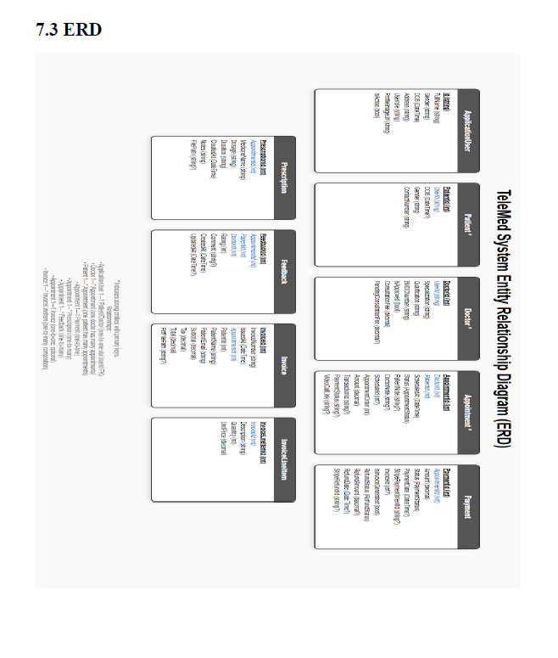

Slide 9
User Requirements!
User requirements describe what patients, doctors, and administrators expect from the Telemedicine System. These requirements reflect real-world needs and outline the interactions, services, and experiences the system must provide.

Slide 10
User Requirements (Cont.)
i. Patients can create an account using email or phone and manage a personal profile containing basic demographic and medical information.
ii. Doctors can register on the platform by submitting personal information, qualifications, professional documents, consultation preferences, and availability.
iii. Patients can search for doctors based on specialization, availability, consultation type, fees, and other relevant filters.
iv. Patients can book in-person or online consultations by selecting preferred doctors, dates, and time slots.
v. Both patients and doctors can manage appointments, including viewing upcoming sessions, cancellations.

Slide 11
User Requirements (Cont.)
vi. Patients and doctors can join secure online consultation sessions with support for chat, file sharing, and video communication.
vii. Doctors can issue prescriptions, medical notes, and consultation summaries, while patients can view or download them anytime.
viii. Patients can complete payments for consultations through integrated payment methods and receive digital receipts.
ix. Admins can monitor system activities, approve doctor registrations, manage users, and generate reports.

Slide 12
System Requirements!
System requirements define the technical, functional, and operational capabilities the TeleMed System must implement to satisfy user requirements. These requirements guide system design, development, and evaluation.

Slide 13
System Requirements (Cont.)
UR#1: Patients can create an account using email or phone and manage a personal profile containing basic demographic and medical information.
The system must allow users to register, authenticate, secure their accounts, and manage profiles.
1.1 The system shall provide registration via email or phone, collecting identity information and login credentials. 1.2 The system shall allow uploading of profile photographs and relevant medical or professional documents. 1.3 The system shall validate uploaded document types and enforce secure storage. 1.4 Users may update or delete non-sensitive profile data. 1.5 The system shall maintain audit logs for profile changes and protect sensitive fields using encryption. 1.6 The system shall authenticate users with valid credentials before granting access. 1.7 Incorrect login attempts beyond a limit shall trigger account lockout. 1.8 Users may reset passwords through verified OTP or email-based recovery. 1.9 The system shall prevent unauthorized access to protected resources.

Slide 14
System Requirements (Cont.)
UR#2: Doctors can register on the platform by submitting personal information, qualifications, professional documents, consultation preferences, and availability.
The system must allow secure registration and validation of doctor credentials.
2.1 The system shall allow doctors to upload credentials, qualification documents, and certifications. 2.2 Admins shall review and approve doctor registrations before activation. 2.3 The system shall verify document authenticity where possible. 2.4 Doctors may manage consultation preferences, fees, and availability settings.

Slide 15
System Requirements (Cont.)
UR#3: Patients can search for doctors based on specialization, availability, consultation type, fees, and other relevant filters.
The system must support searching, booking, and managing consultations.
3.1 Patients can search for doctors based on specialty, availability, language, fee, and location. 3.2 Patients can select doctor, date, time, and consultation type during booking. 3.3 The system shall check slot availability and prevent overlapping appointments. 3.4 Users can reschedule or cancel appointments according to system rules. 3.5 Both patient and doctor can view appointment status and details.

Slide 16
System Requirements (Cont.)
UR#4: Patients can book in-person or online consultations by selecting preferred doctors, dates, and time slots.
The system must support secure online and offline consultations.
4.1 The system shall generate secure, time-limited video session links for online appointments. 4.2 Consultation screens shall support chat, attachments, and session controls. 4.3 Doctors may mark sessions as started, paused, completed, or cancelled. 4.4 The system shall log timestamps for billing and auditing.

Slide 17
System Requirements (Cont.)
UR#5: Both patients and doctors can manage appointments, including viewing upcoming sessions, rescheduling, and cancellations.
The system must support secure creation and sharing of medical records.
5.1 Doctors can create digital prescriptions and consultation notes. 5.2 Patients may view and download prescriptions. 5.3 The system shall maintain version history and immutable audit logs. 5.4 Access to patient data shall require proper consent and role-based permissions.

Slide 18
System Requirements (Cont.)
UR#6: Patients and doctors can join secure online consultation sessions with support for chat, file sharing, and video communication.
The system must support secure and transparent payment handling.
6.1 Patients can pay consultation fees using integrated payment gateways. 6.2 The system shall update appointment payment status automatically. 6.3 Paid sessions generate downloadable digital receipts. 6.4 Admins and doctors can view transaction histories and earnings summaries.

Slide 19
System Requirements (Cont.)
UR#7: Doctors can issue prescriptions, medical notes, and consultation summaries, while patients can view or download them anytime.
The system must make it easy to find relevant doctors.
7.1 Search filters include specialization, location, availability, rating, and consultation fees. 7.2 Results should show next available slot and quick booking options. 7.3 Search queries must be optimized for speed through indexed and cached mechanisms.

Slide 20
System Requirements (Cont.)
UR#8: Patients can complete payments for consultations through integrated payment methods and receive digital receipts.
The system must provide dashboards and exportable reports.
8.1 Admins can view KPIs such as total appointments, revenue, top doctors, and cancellations. 8.2 Reports can be generated on daily, weekly, and monthly bases. 8.3 Doctors can view personal performance and earning statistics.

Slide 21
System Requirements (Cont.)
UR#9: Admins can monitor system activities, approve doctor registrations, manage users, and generate reports.
The system must ensure data protection and continuity.
9.1 The system shall automatically back up the database every 24 hours. 9.2 Admins can trigger manual backups and restore operations. 9.3 All critical actions must be logged with timestamps and user identifiers.

Slide 22
Functional Requirements!
Functional requirements define what the TeleMed System must do:
• Allow users to register, authenticate, and access the system. • Enable patients to manage profiles, book appointments, and view records. • Support doctors in managing schedules, consultations, and medical documents. • Handle payments, generate receipts, and maintain transaction integrity. • Provide secure online consultation capabilities. • Ensure admin oversight through user management, reports, and audits.

Slide 23
Non-functional Requirements!
Non-functional requirements describe how a system works, not what the system does.

Slide 24
Non-functional Requirements (Cont.)
Performance
• Pages must load within two seconds under normal conditions. • Searches should return results within one second. • The system should support multiple simultaneous consultations without degraded performance.
Reliability & Availability
• The system must maintain at least 99.5% uptime. • Database backups must ensure a maximum of 24 hours of data loss.

Slide 25
Non-functional Requirements (Cont.)
Security
• All communication must use HTTPS encryption. • Passwords must be stored securely using hashing and salting. • Unauthorized access attempts must be logged.
Usability
• Users should be able to reach key features within three clicks. • UI elements must remain consistent across the platform.
Scalability
• The platform should support horizontal scaling as user count grows.

Slide 26
Non-functional Requirements (Cont.)
Maintainability
• Code should follow modular architecture and standard naming conventions.
Portability
• The system must run on Windows or Linux servers and support container deployment.
Compliance
• Medical data must comply with regional privacy regulations.

Slide 27
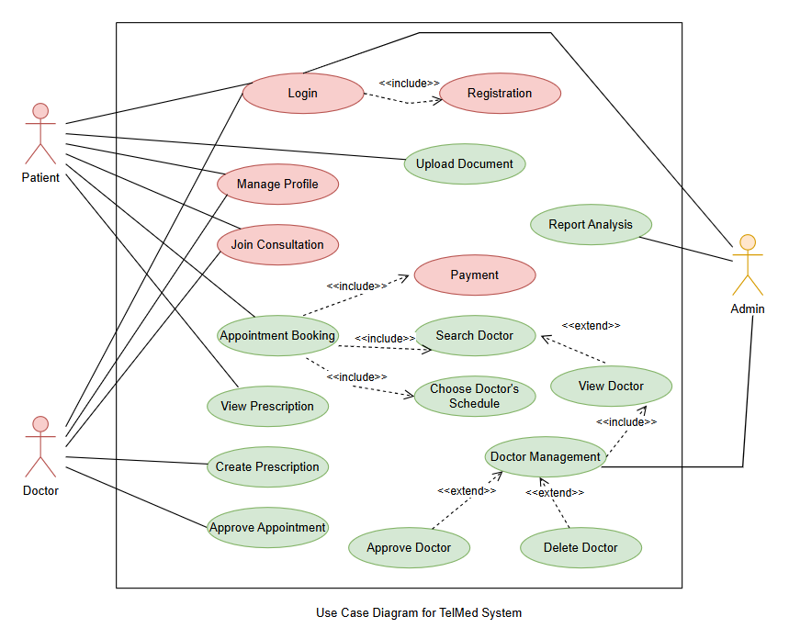

Slide 28
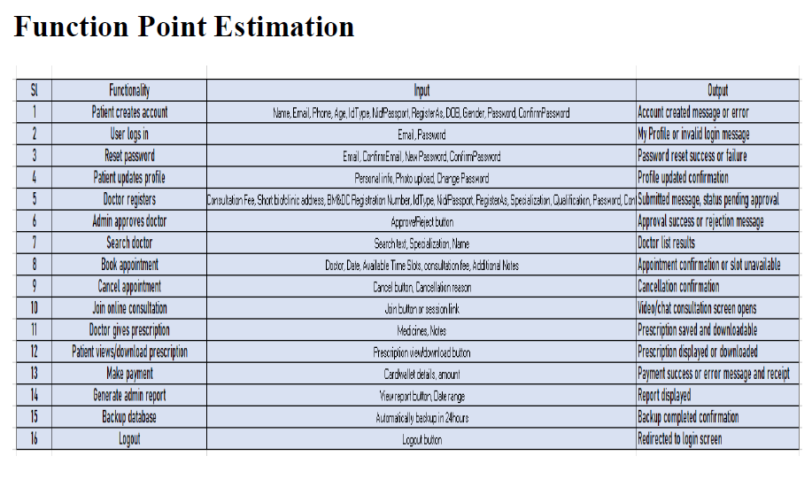

Slide 29
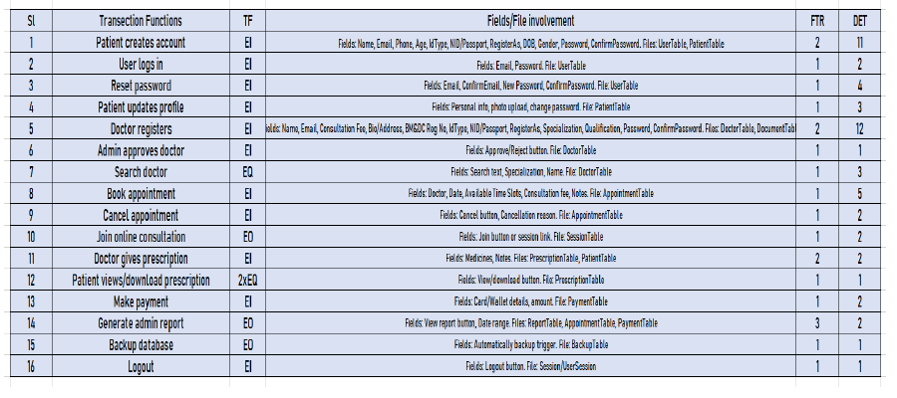

Slide 30
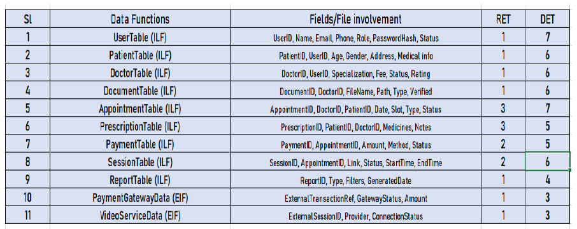

Slide 31
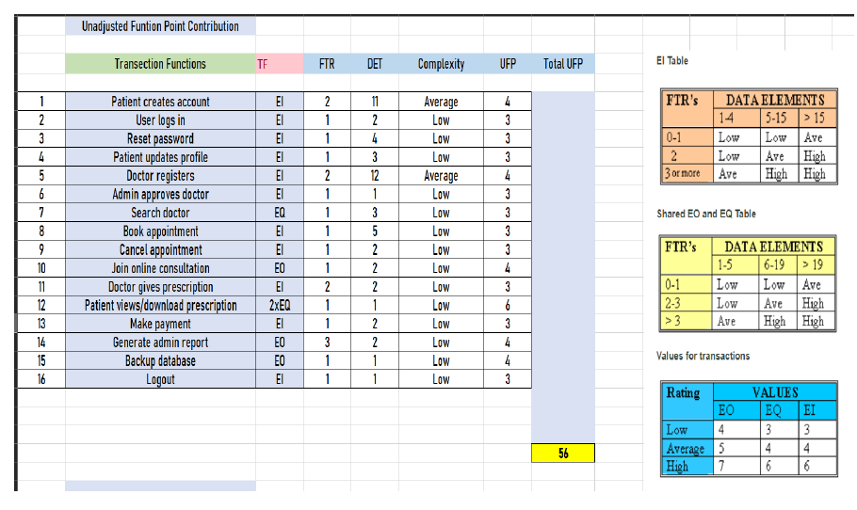

Slide 32
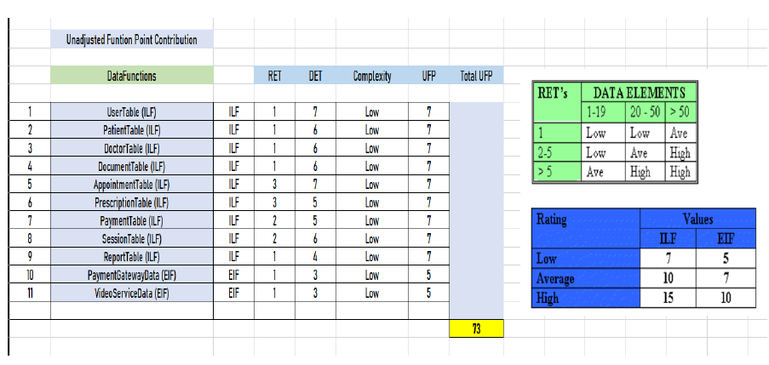

Slide 33
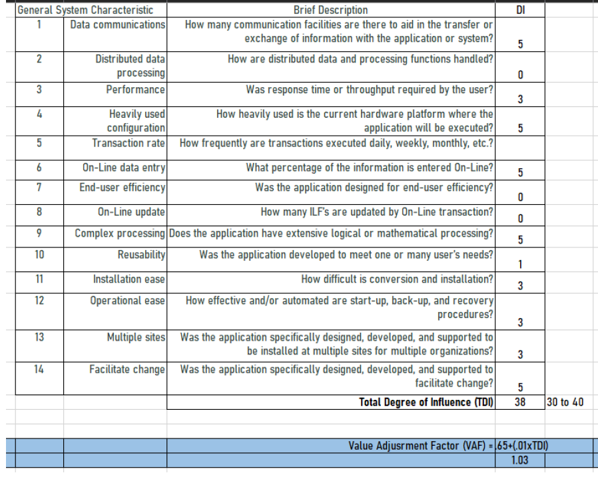

Slide 34
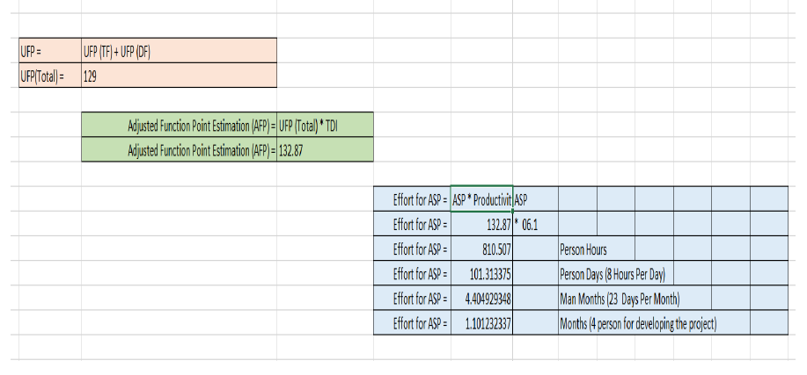

Slide 35
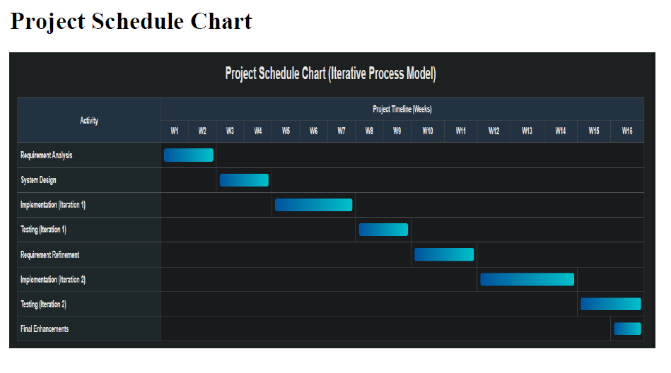

Slide 36
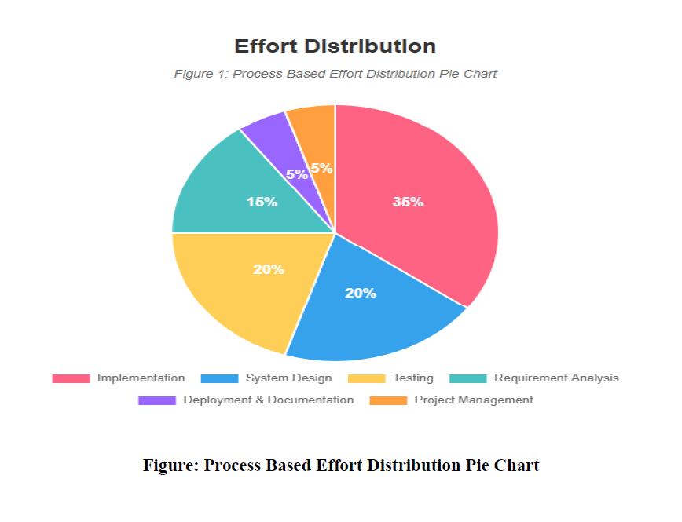

Slide 37
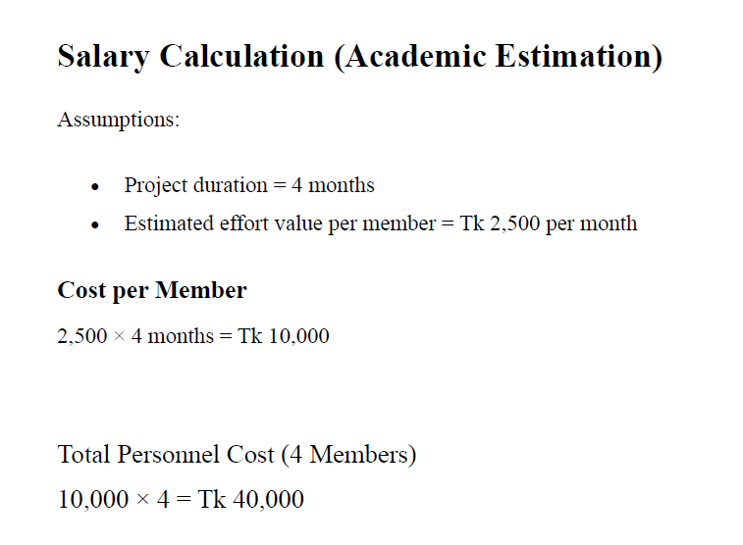

Slide 38
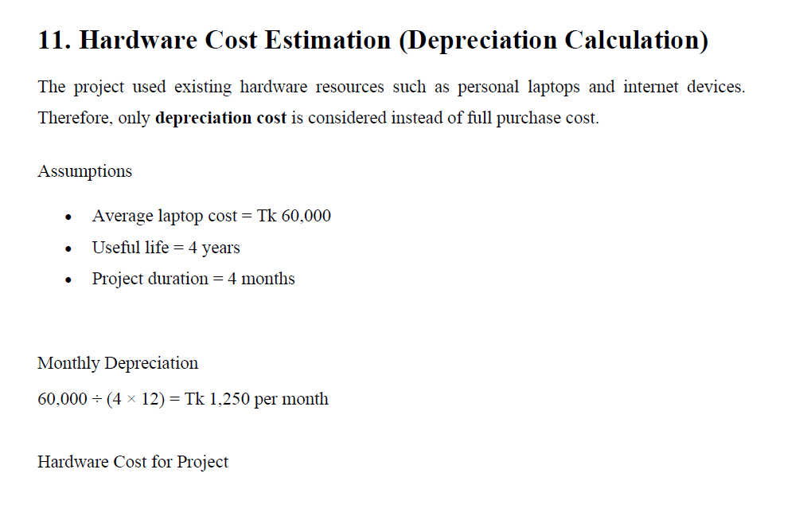

Slide 39
Selected Process Model
The Iterative Model
A hybrid approach that combines elements of waterfall and evolutionary paradigms, delivering the system in functional iterative.
Key Characteristics
System functionality delivered in increments
Each increment adds new features to the system
Early increments serve as prototypes for later ones
Supports iterative refinement and testing

Slide 40
Iterative Development Plan for TeleMed
1
2
3
Core Authentication & User Management
Implemented ASP.NET Identity with role-based access control for Admin, Doctor, and Patient roles. Basic user registration and login functionality.
Appointment Scheduling System
Developed appointment booking functionality, schedule management for doctors, and appointment viewing/management for patients.
Video Consultation Feature
Integrated virtual video session capabilities for real-time doctor-patient consultations.
Prescription Management System
Implemented digital prescription creation using QuestPDF, file upload/download functionality, and prescription viewing for patients.
Admin Dashboard & Reporting
Built admin panel for doctor approval, schedule management, payment summaries, and system-wide reports.
4
5

Slide 41
Why Iterative Model for TeleMed?
Project-Specific Justifications
Multiple Independent Modules: The system has distinct subsystems (authentication, appointments, video, prescriptions, admin) that can be developed and delivered separately
Early Functional Delivery: Core features like user registration and appointment booking could be delivered early while advanced features were being developed
Risk Management: Each increment reduced technical risks by validating critical features (authentication, video integration) early in development
Easier Integration: The modular nature of TeleMed aligned perfectly with incremental integration of subsystems
Priority-Based Development: Critical features (security, basic appointments) were implemented first, followed by enhancements

Slide 42
Advantages for TeleMed Development
Early Value Delivery: Basic telemedicine functionality was available early, allowing for early testing and feedback
Reduced Project Failure Risk: Each increment validated the approach, reducing the risk of complete project failure
Better Process Iteration: Lessons learned from early increments (like authentication) improved later increments (like video sessions)
Flexible Priority Management: Could adjust priorities based on stakeholder feedback (e.g., prioritizing prescription management over advanced reporting)
Parallel Development Opportunities: Different teams or developers could work on different increments simultaneously
Continuous Testing: Each increment was fully tested before moving to the next, ensuring quality

Slide 43
Why Not Other Models?
Model | Suitable? | Reason
Waterfall Model | No | Requirements were not completely defined upfront; changes were expected during development
Prototyping | No | Not just a prototype needed; required a fully functional, production-ready system
Spiral Model | No | Too complex for a university project; requires extensive risk assessment expertise
Evolutionary Development | Partial | While some evolution occurred, the structured incremental approach provided better control
Iterative Model | ✓Yes | Perfect fit: modular system, manageable complexity, ability to deliver working parts early

Slide 44
Evidence of Incremental Development
Observable Patterns in the Project
Modular Architecture: Clear separation between authentication module, appointment module, prescription module, and admin module
Progressive Feature Addition: Started with basic CRUD operations, then added file uploads, then integrated video capabilities
Independent Testing: Each module could be tested independently before integration
Layered Database Design: Entity Framework migrations show incremental database schema evolution
Role-Based Progressive Access: User roles were implemented in stages, with Patient first, then Doctor, then Admin
Development Flow
Foundation (Auth & DB) → Appointments → Video Sessions → Prescriptions → Admin Dashboard

Slide 45
Challenges with Incremental Approach
Challenges Faced
Mapping complex requirements (like video integration) to specific increments
Managing dependencies between increments (e.g., prescriptions needed appointments first)
Ensuring consistent design across all increments
Solutions Applied
Created a clear dependency map before starting development
Established design patterns and UI standards in Increment 1
Used Entity Framework Core for consistent data access across increments
Implemented common services and utilities in the foundation increment

Slide 46
Project Outcomes
Successful Delivery
The incremental approach enabled successful delivery of a fully functional telemedicine platform with all planned features.
✓ All Features Delivered
Every planned increment was completed successfully
✓ Quality Maintained
Each increment thoroughly tested before moving forward
✓ Scalable Architecture
Modular design allows easy addition of new features
✓ Production Ready
System is fully functional and deployment-ready

Slide 47
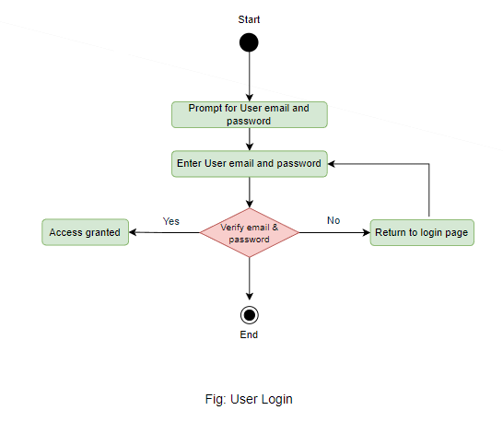
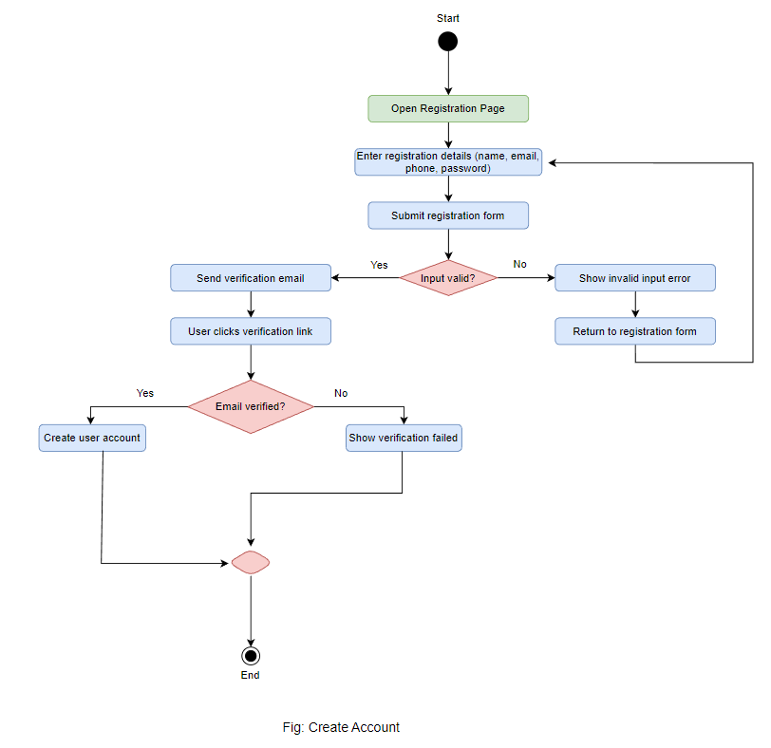
Activity Diagram(Cont.)

Slide 48
Activity Diagram(Cont.)

Slide 49
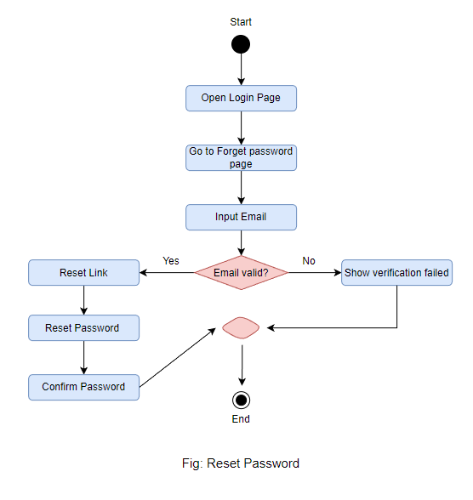
Activity Diagram(Cont.)

Slide 50
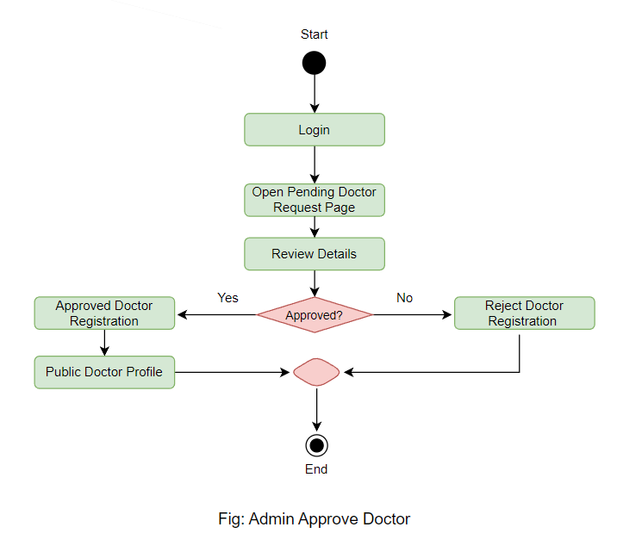
Activity Diagram(Cont.)

Slide 51
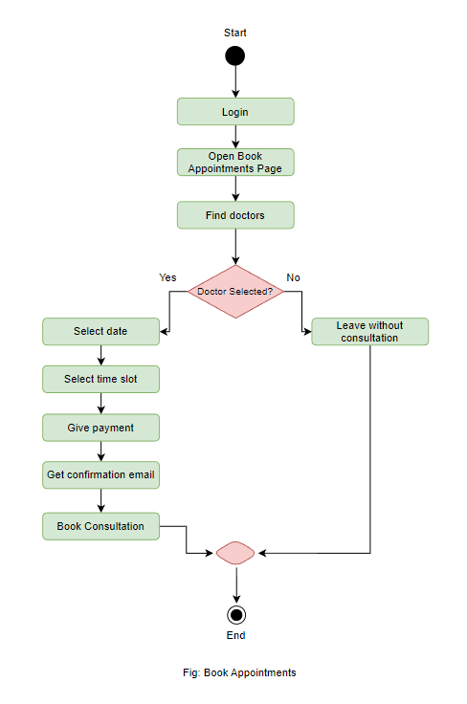
Activity Diagram(Cont.)

Slide 52
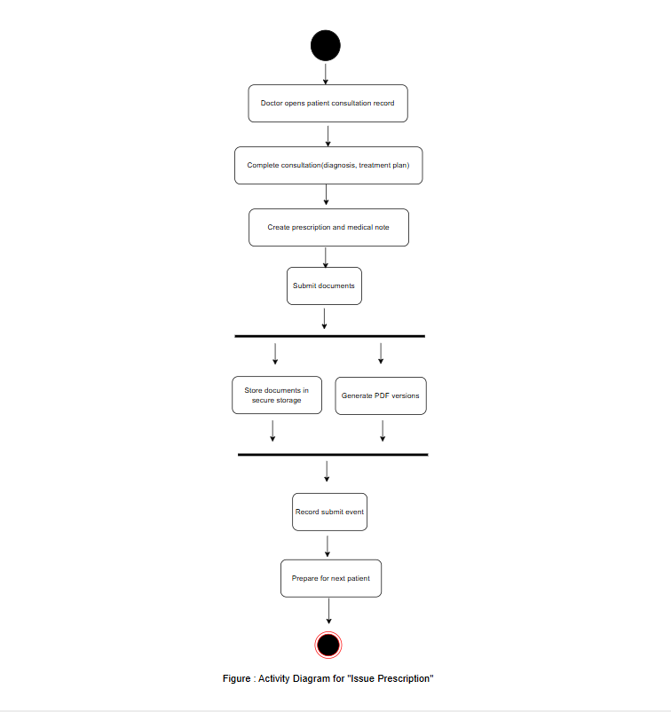
Activity Diagram(Cont.)

Slide 53
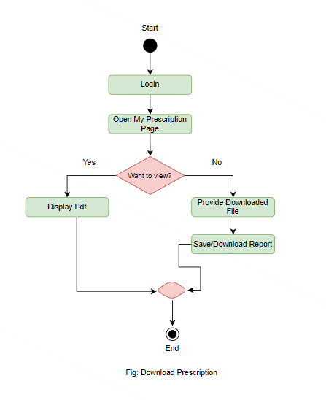
Activity Diagram(Cont.)

Slide 54
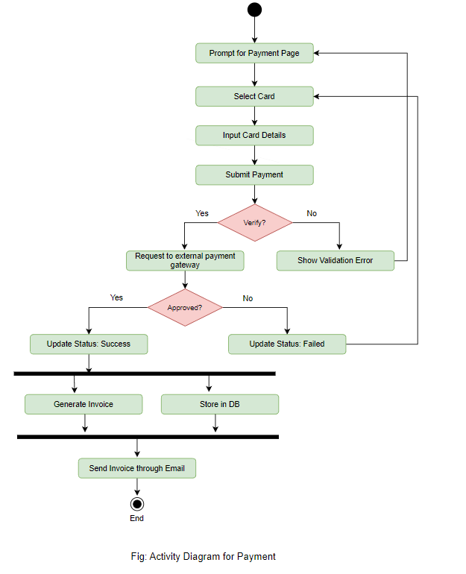
Activity Diagram(Cont.)

Slide 55
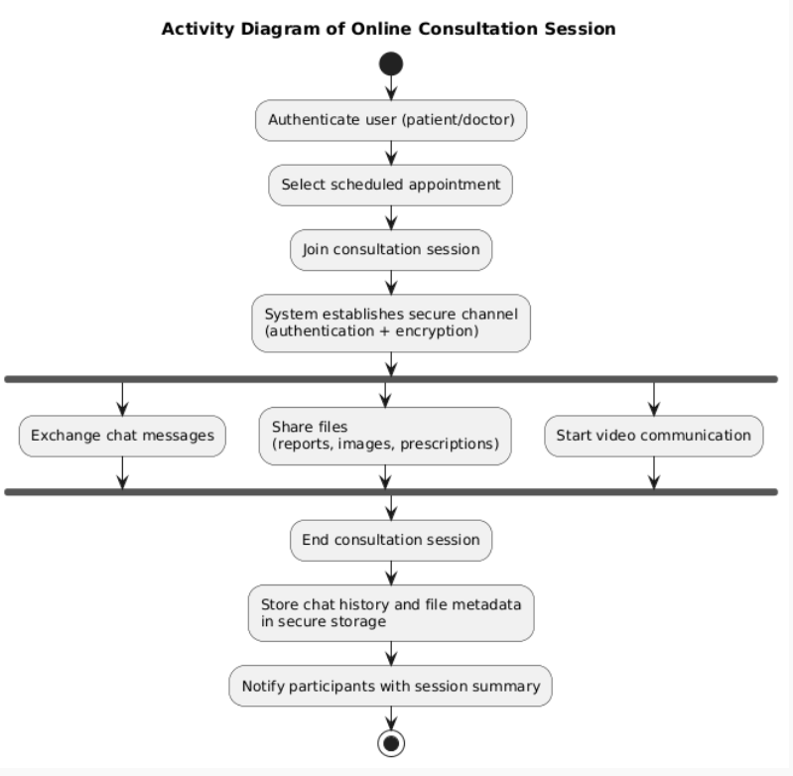
Activity Diagram(Cont.)

Slide 56
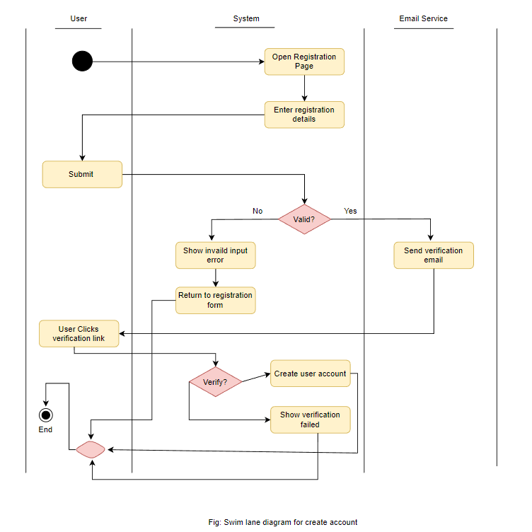
Swim Lane Diagrams(Cont.)

Slide 57
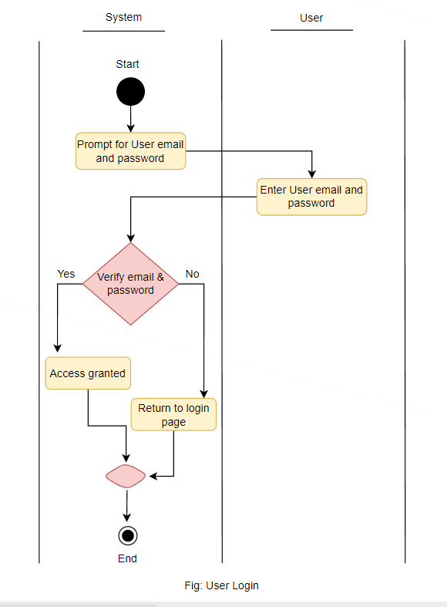
Swim Lane Diagrams(Cont.)

Slide 58
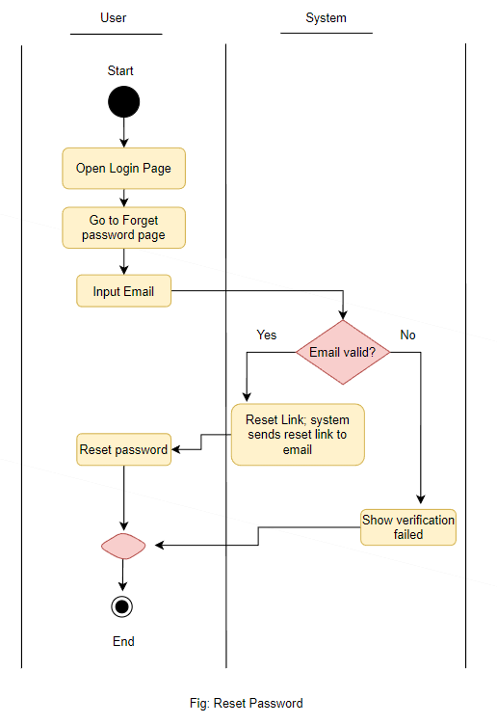
Swim Lane Diagrams(Cont.)

Slide 59
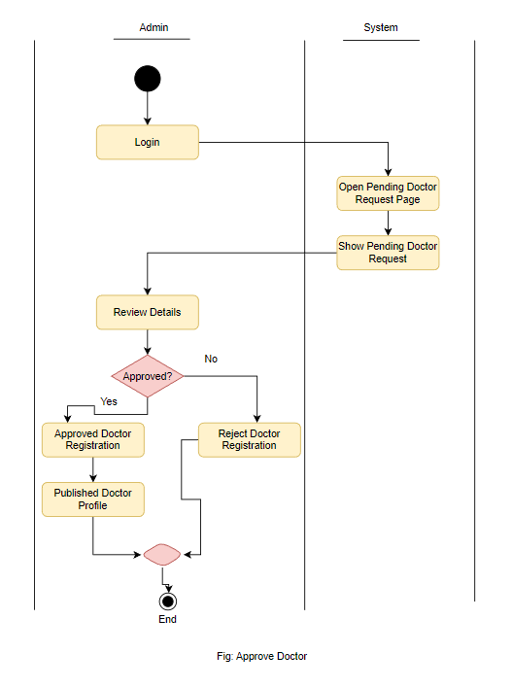
Swim Lane Diagrams(Cont.)

Slide 60
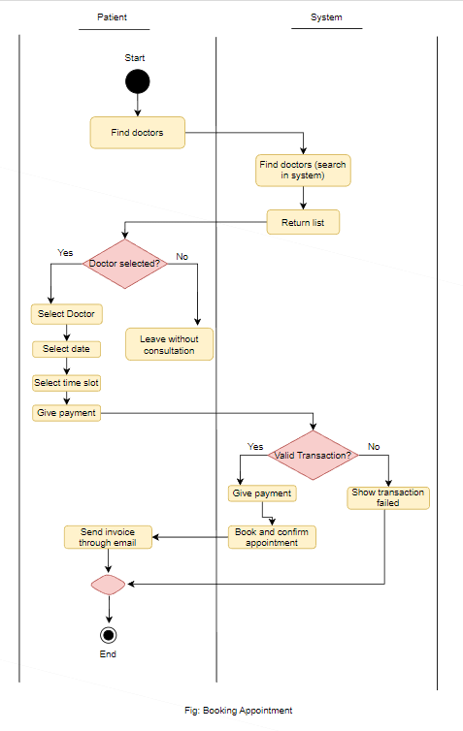
Swim Lane Diagrams(Cont.)

Slide 61
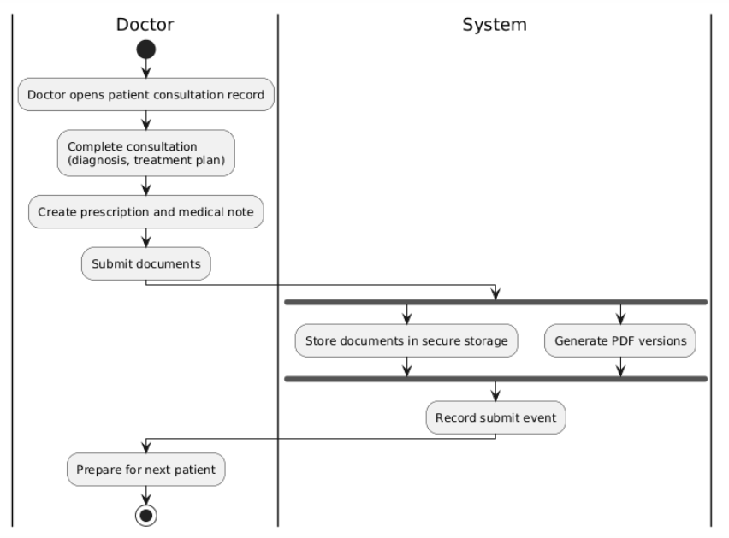
Swim Lane Diagrams(Cont.)

Slide 62
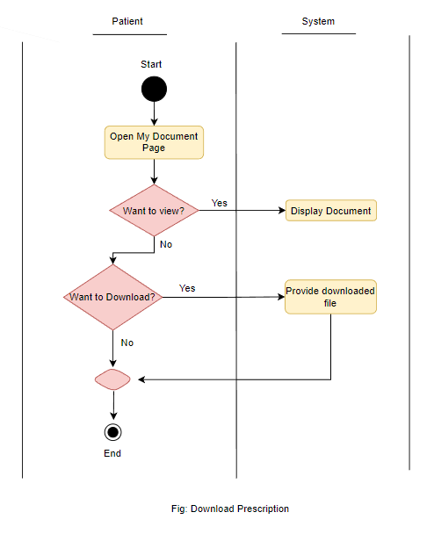
Swim Lane Diagrams(Cont.)

Slide 63
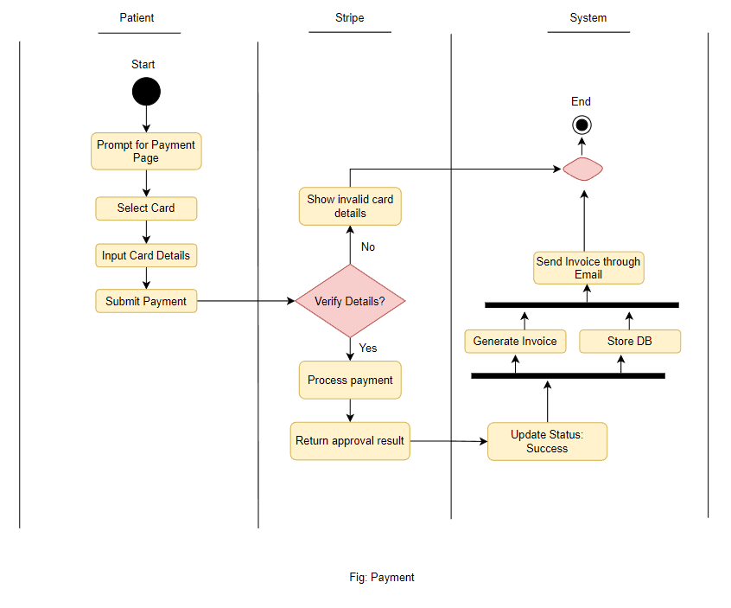
Swim Lane Diagrams(Cont.)

Slide 64
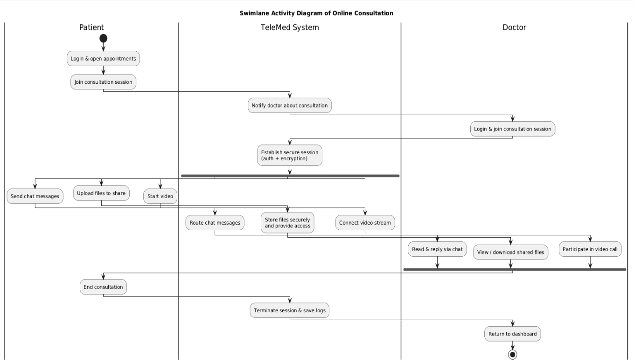
Swim Lane Diagrams(Cont.)

Slide 65
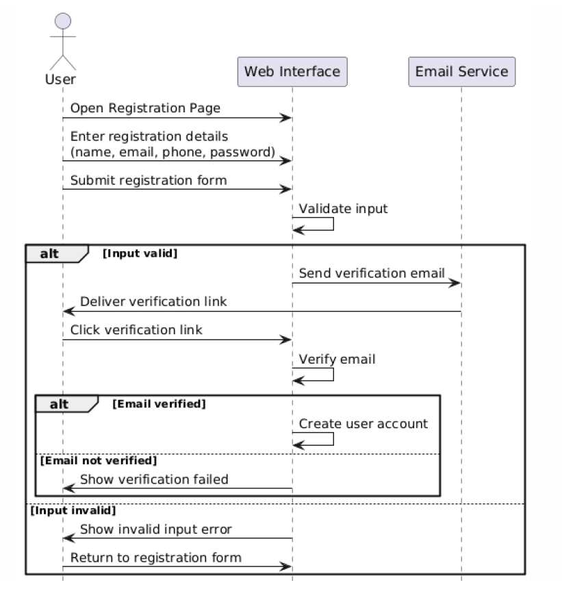
Sequence Diagrams(Cont.)
Fig: Create Account

Slide 66
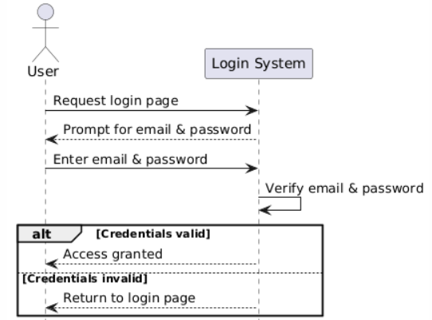
Sequence Diagrams(Cont.)
Fig: User Login

Slide 67
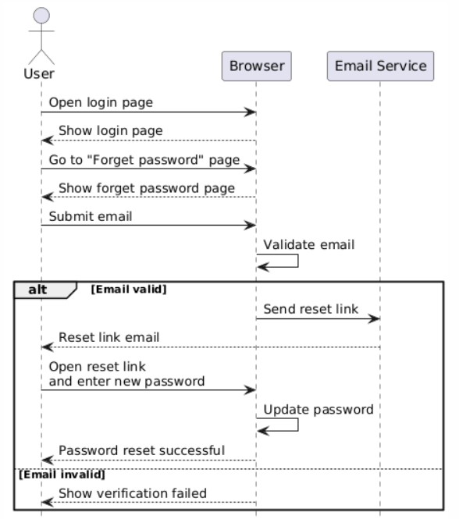
Sequence Diagrams(Cont.)
Fig: Reset Password

Slide 68
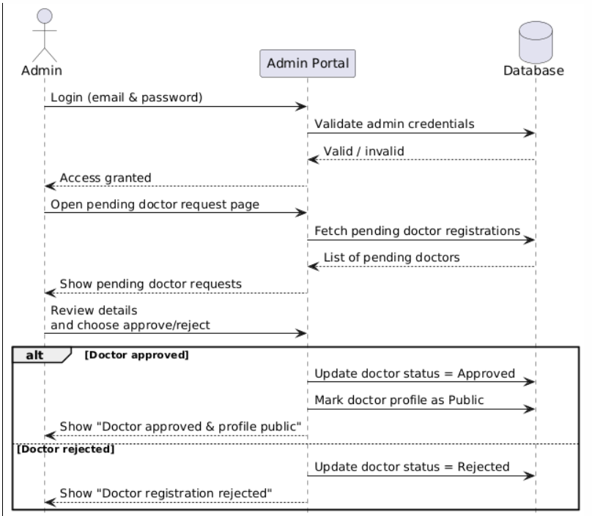
Sequence Diagrams(Cont.)
Fig: Approve Doctor

Slide 69
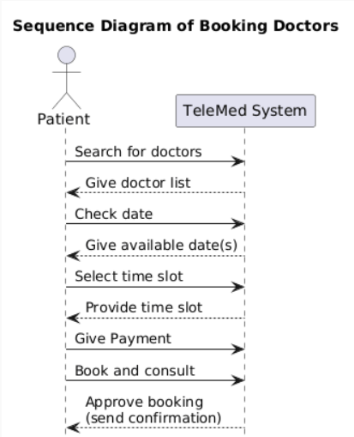
Sequence Diagrams(Cont.)

Slide 70
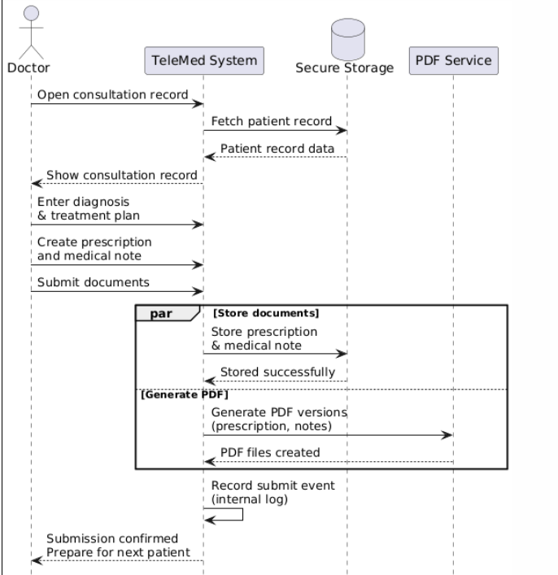
Sequence Diagrams(Cont.)
Fig: Issue Prescription

Slide 71
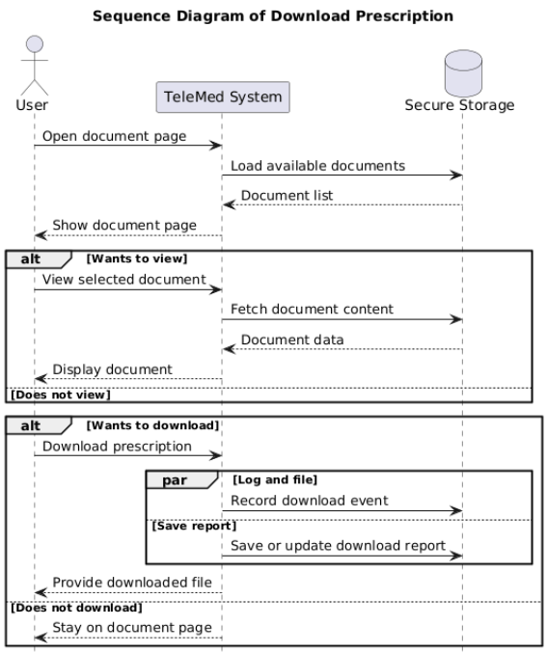
Sequence Diagrams(Cont.)

Slide 72
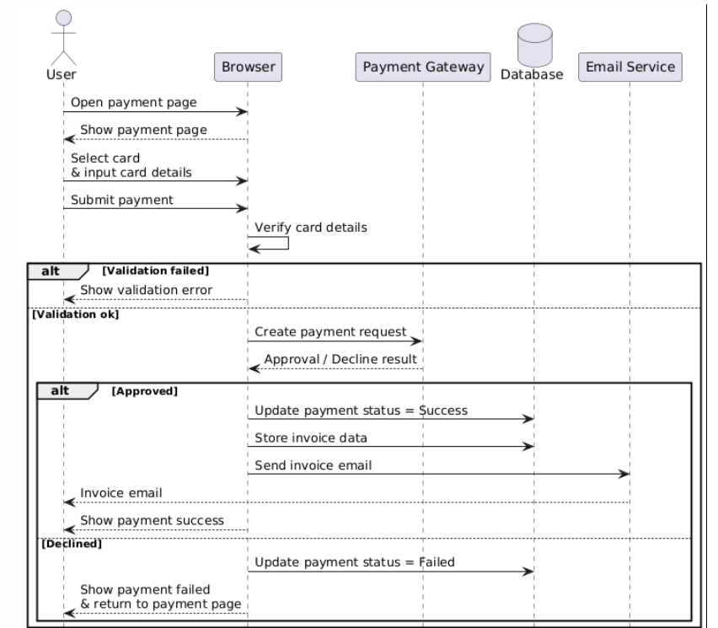
Sequence Diagrams(Cont.)
Fig: Payment

Slide 73
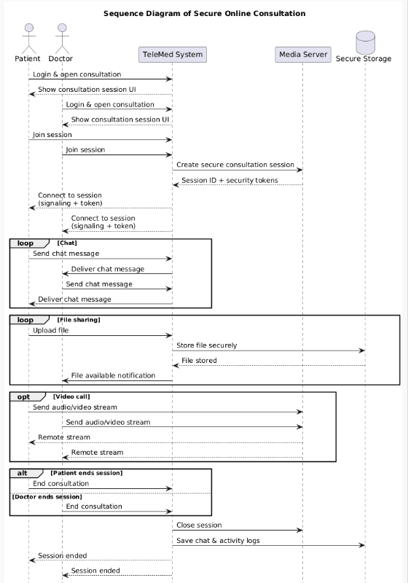
Sequence Diagrams(Cont.)

Slide 74
CRC Cards (Cont.)
Class name: Payment
Class type: Occurrence / Event
Characteristics: Abstract, atomic, sequential, persistent, guarded
Responsibilities: Store payment amount. Update status. Trigger invoice creation | Collaborators: Appointment Invoice Invoice

Slide 75
CRC Cards (Cont.)
Class name: Invoice
Class type: Thing
Characteristics: Abstract, aggregate, sequential, persistent, guarded
Responsibilities: Store Invoice metadata Hold PDF path Provide proof of payment | Collaborators: Payment

Slide 76
CRC Cards (Cont.)
Class name: ConsultationSession
Class type: Occurrence / Event
Characteristics: Abstract, aggregate, concurrent, persistent, guarded
Responsibilities: Start and end the session Hold chat and file sharing data Support video sharing metadata | Collaborators: Appointment, Doctor, Patient ChatMessage, FileAttachment

Slide 77
CRC Cards (Cont.)
Class name: ChatMessage
Class type: Occurrence / Event
Characteristics: Abstract, atomic, sequential, persistent, guarded
Responsibilities: Show sender and content | Collaborators: ConsultationSession, Doctor, Patient

Slide 78
CRC Cards (Cont.)
Class name: FileAttachment
Class type: Thing
Characteristics: Abstract, atomic, sequential, persistent, guarded
Responsibilities: Store file metadata and path Provide downloadable content | Collaborators: ConsultationSession

Slide 79
CRC Cards (Cont.)
Class name: PrescriptionDocument
Class type: Thing
Characteristics: Abstract, aggregate, sequential, persistent, guarded
Responsibilities: Store Prescription Data Provide downloadable file path | Collaborators: Appointment

Slide 80
CRC Cards (Cont.)
Class Name: ApplicationUser
Class type: External entity
Characteristics: Abstract, atomic, sequential, persistent, guarded
Responsibilities: Store user login information Maintain role association Provide contact details for notifications | Collaborators: Doctor Patient Admin

Slide 81
CRC Cards (Cont.)
Class Name: Doctor
Class type: Role
Characteristics: Tangible, aggregate, sequential, persistent, guarded
Responsibilities: Manage professional profile Control schedule Accept or reject appointments Conduct consultations Create prescriptions View Feedback | Collaborators: ApplicationUser DoctorSchedule Appointment ConsultationSession PrescriptionDocument Feedback

Slide 82
CRC Cards (Cont.)
Class Name: Patient
Class type: Role
Characteristics: Tangible, aggregate, sequential, persistent, guarded
Responsibilities: Browse doctors Book and cancel appointments Join consultation sessions Download prescriptions and invoices Give Payment Give feedback | Collaborators: ApplicationUser Appointment ConsultationSession PrescriptionDocument Payment, Invoice Feedback

Slide 83
CRC Cards (Cont.)
Class Name: Admin
Class type: Role
Characteristics: Tangible, atomic, sequential, persistent, guarded
Responsibilities: Approve or reject doctor applications Manage system data View reports | Collaborators: ApplicationUser, Doctor Patient, Doctor

Slide 84
CRC Cards (Cont.)
Class Name: DoctorSchedule
Class type: Event
Characteristics: Abstract, aggregate, sequential, persistent, guarded
Responsibilities: Store available time slots Validate booking availability | Collaborators: Doctor Appointment

Slide 85
CRC Cards (Cont.)
Class Name: Appointment
Class type: Occurrence / Event
Characteristics: Abstract, aggregate, sequential, persistent, guarded
Responsibilities: Track date, time, and status Link doctor and patient Maintain payment status Link consultations, prescriptions, and feedback | Collaborators: DoctorSchedule Doctor, Patient Payment ConsultationSession, PrescriptionDocument, Feedback

Slide 86
CRC Cards (Cont.)
Class name: Feedback
Class type: Occurrence / Event
Characteristics: Abstract, Atomic, Concurrent, Persistent, Guarded
Responsibilities: Show and store rating and comment Associate to appointment and doctor | Collaborators: Appointment, Patient Appointment, Doctor

Slide 87
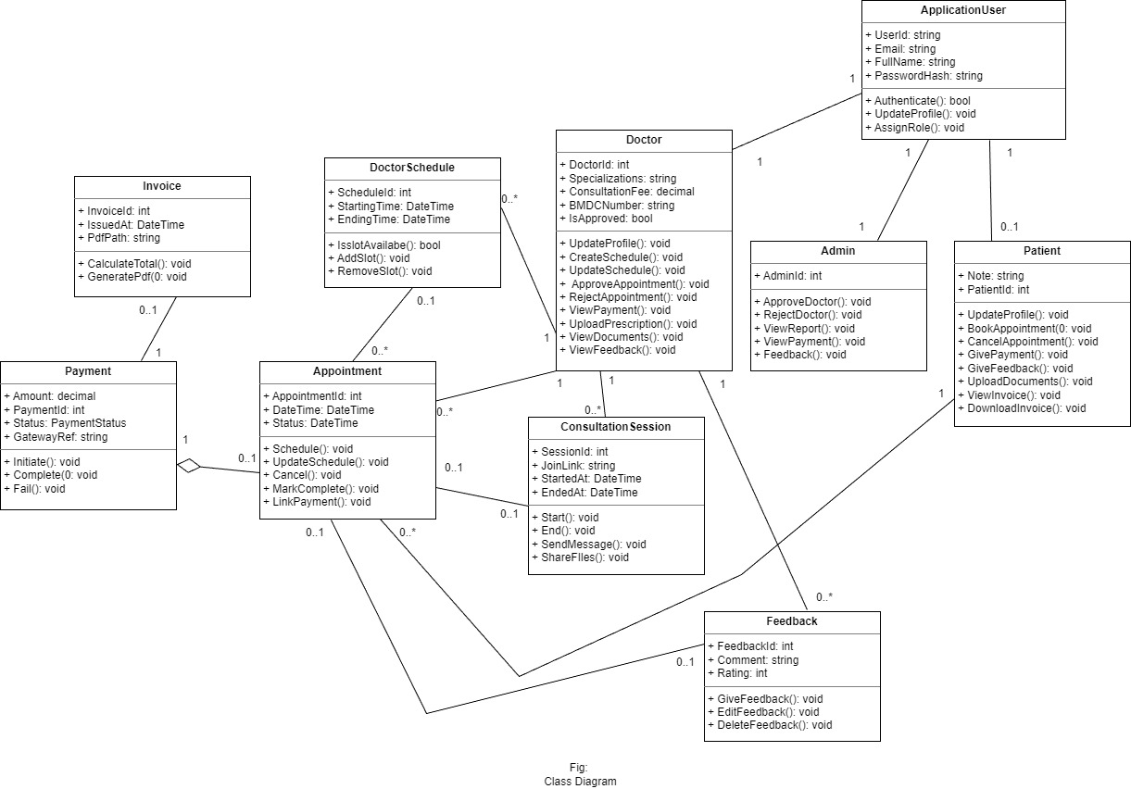
Class Diagram

Slide 88
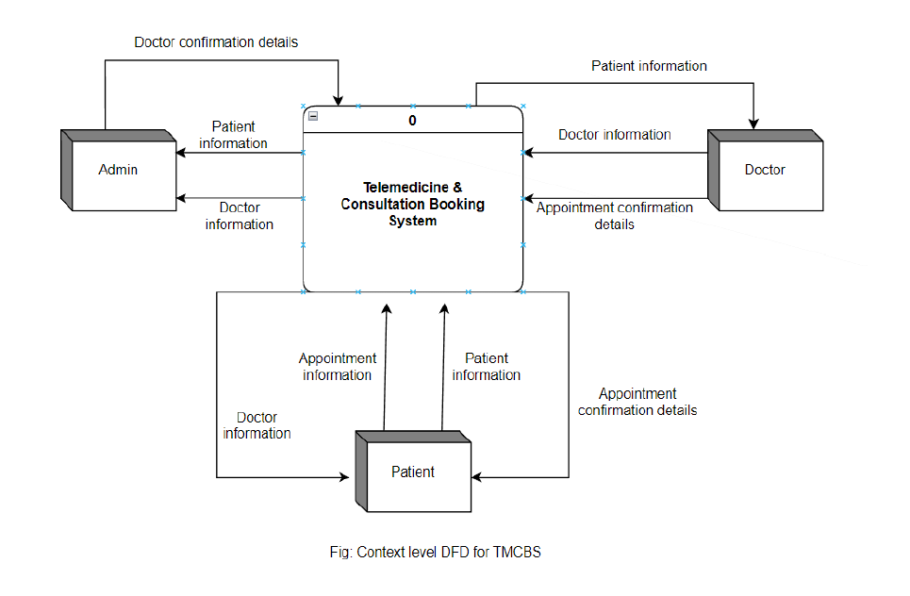

Slide 89
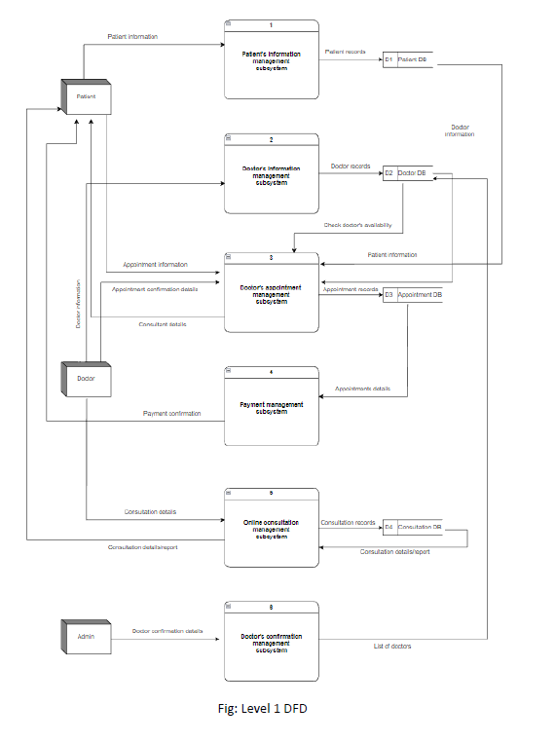

Slide 90
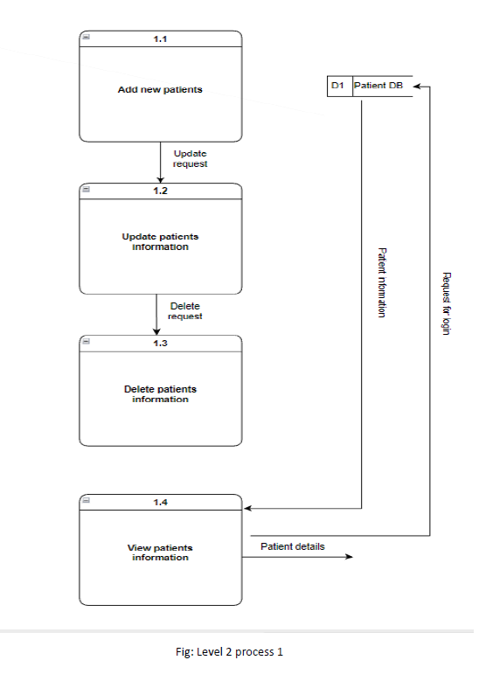

Slide 91
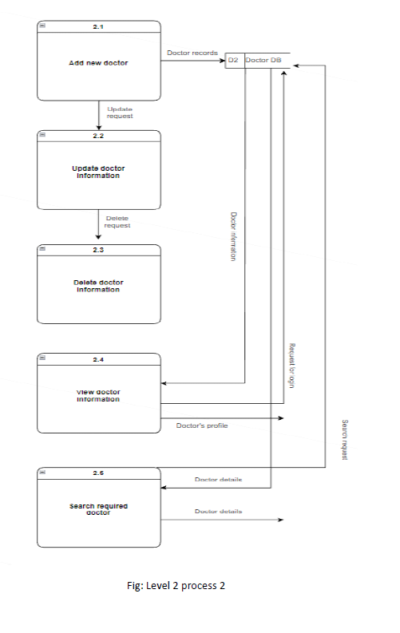

Slide 92
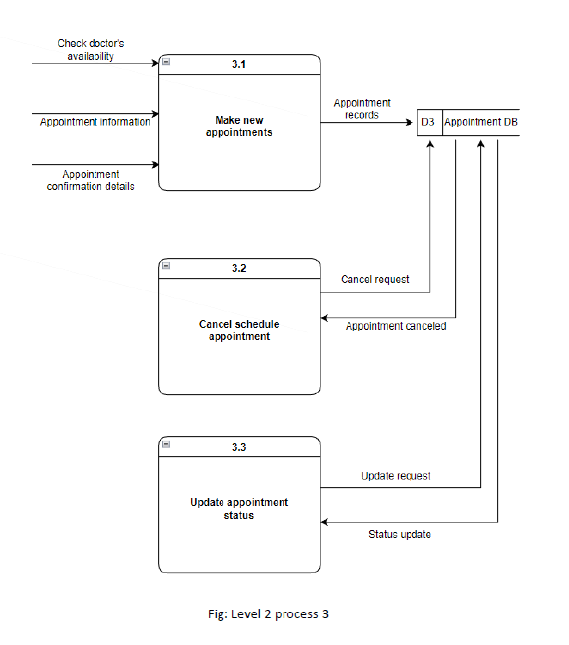

Slide 93
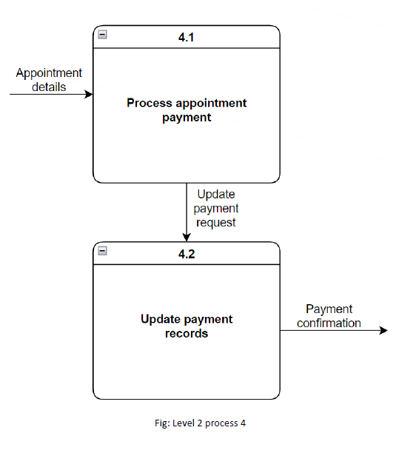

Slide 94
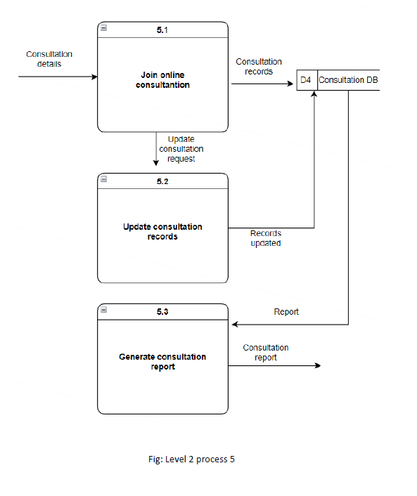

Slide 95
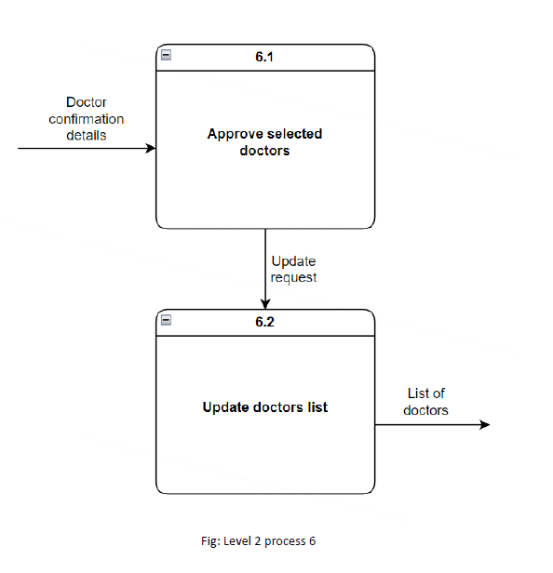

Slide 96
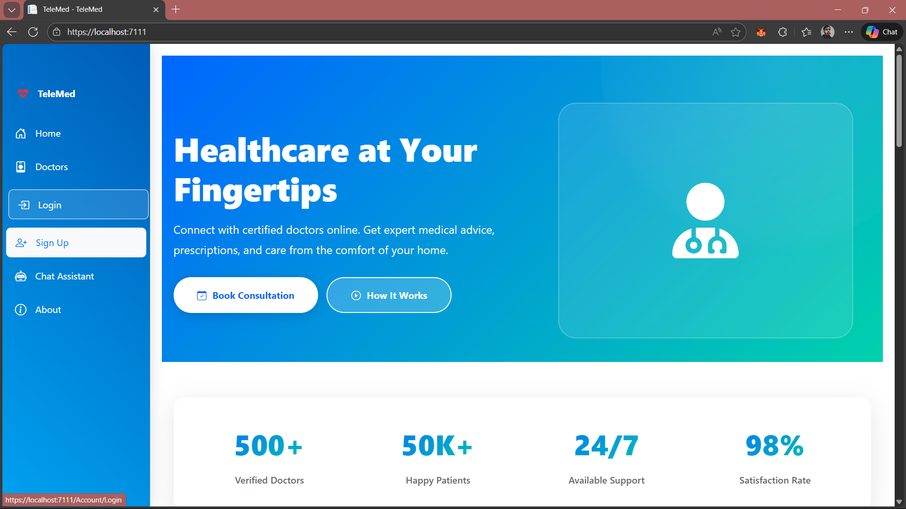

Slide 97
System Architecture / Work flow
User
Login/Register
Admin Approve Doctors
Patient Select Doctor
Doctor
Manage Appointment
Patient
Book Appointment
Patient
Make payment
Database stores
users + appointments

Slide 98
Key Features
Patient registration/login
Doctor registration/login
Appointment booking & management
Doctor profile & availability
Make payment through secure payment gateway
Admin control
AI integration

Slide 99


Slide 100


Slide 101


Slide 102
Patient Module
Patient can create account and login
Browse doctors
Book appointment
View appointment history

Slide 103


Slide 104


Slide 105


Slide 106
Doctor Module
Doctor can login
Manage appointments
View patient details
Provide consultation updates

Slide 107


Slide 108


Slide 109


Slide 110


Slide 111


Slide 112


Slide 113


Slide 114


Slide 115
Admin Module
Admin manages system users
Controls doctors/patients data
Manages platform monitoring

Slide 116


Slide 117


Slide 118


Slide 119


Slide 120


Slide 121


Slide 122


Slide 123


Slide 124


Slide 125


Slide 126


Slide 127


Slide 128


Slide 129
⚠️ Limitations
This project works well, but like any real system, it has boundaries. These help reviewers see that you understand tradeoffs.
System currently depends on reliable internet access for most features.
Payment testing may rely on sandbox mode instead of fully live production transactions.
AI chatbot suggestions are supportive, not medically certified or expert-approved.
Refund logic follows predefined rules and may not handle all real-world edge cases.
No mobile app version yet, only web-based.
Role permissions are predefined and not configurable through UI.
Performance not fully stress-tested for very high traffic.

Slide 130
Conclusion !
TeleMed System makes healthcare access easier, faster, and more organized through online appointment & consultation support.

Slide 131

Thanks!
Let me know, if you have any questions?

